Slide 1




Data-Limited Fisheries Toolkit
Evaluating management strategies for data-limited fish species
Time varying parameters and ecosystem considerations
Lecture 6b, May 2017
Tom Carruthers & Adrian Hordyk .
Nicolas Gutierrez

Slide 2
Agenda
Growth
M (natural mortality rate)
Recruitment

Slide 3
Growth
Many papers have cited impacts on growth in response to changing ocean conditions, prey availability or increased predation.
While DLMtool does not contain explicit climate models or (currently) explicit ecosystem dynamics models, it does allow for time-changing parameters.
These time-varying parameter values may be based on research and included in the reference set of operating models or alternatively plausible scenarios could be proposed for robustness testing.
Note that changes in growth are likely to affect various classes of MPs very differently *

Slide 4
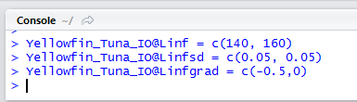
Parameterizing growth changes
DLMtool currently provides temporal control of just two parameters: the maximum length (Linf) and the growth rate K.
In addition to uncertainty in their mean values, variability among years, you can also specify a % annual change (Linfgrad, Kgrad)
For example if you wanted to specify a mean value of Linf of between 140 - 160 cm with a +/- 15 cm annual variability and up to a 0.5 % annual decrease, the R code would be:

Slide 5


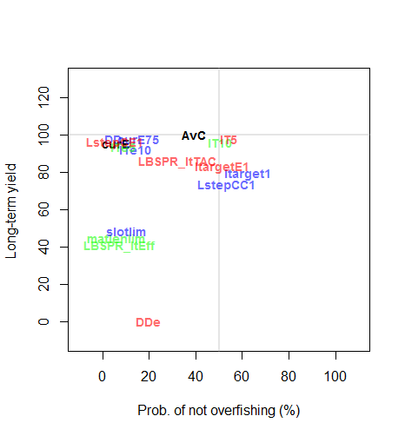
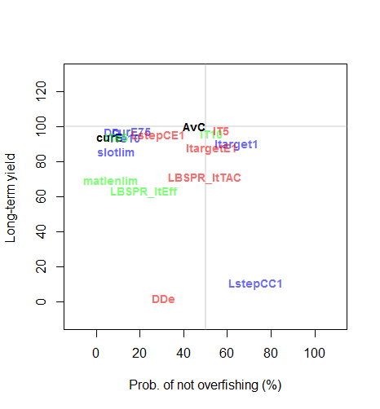
Effects of changes in growth are unpredictable

Slide 6
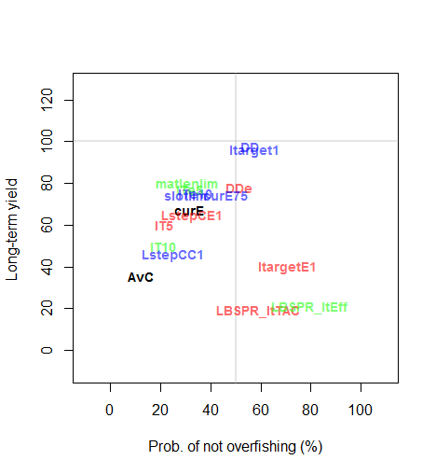
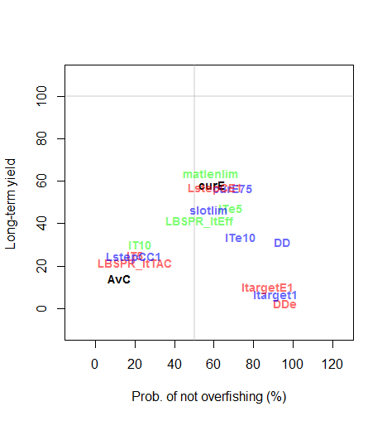

Natural mortality rate
Changes in M lead to fundamental shifts in the age-structure of the population and can have profound impacts on productivity and various data such as unfished mean size and catch composition.
For example, in the absence of First Nations hunting, 5 fold increases in the number of marine predators (harbour seals) have lead to estimated increases in M for BC rockfish species of as much as 2-3% over the last half century which could continue:

Slide 7
Recruitment
DLMtool contains a number of slots for specifying recruitment:
Stock@SRrel The stock-recruitment relationship
Stock@h Recruitment compensation (steepness)
Stock@Perr Lognormal recruitment variation
Stock@AC Autocorrelation in recruitment
Stock@Recgrad Gradient in recruitment
Stock@Period The duration of phases
Stock@Amplitude The size of phase shifts

Slide 8
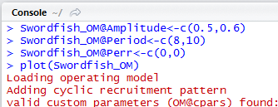
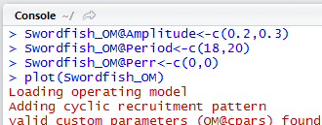
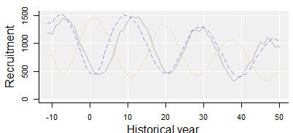
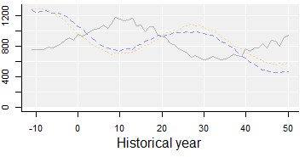
Recruitment phase shifts
Short phases, large magnitude in shift
Longer phases, shallow shifts

Slide 9
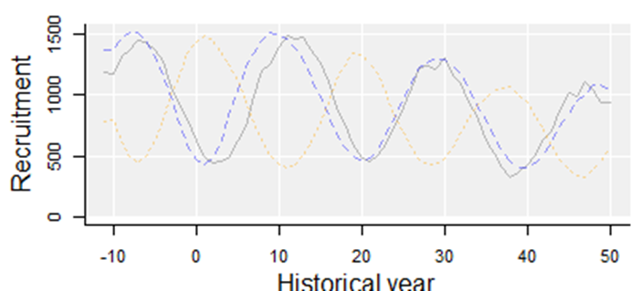
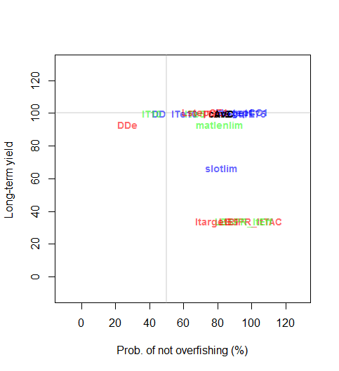
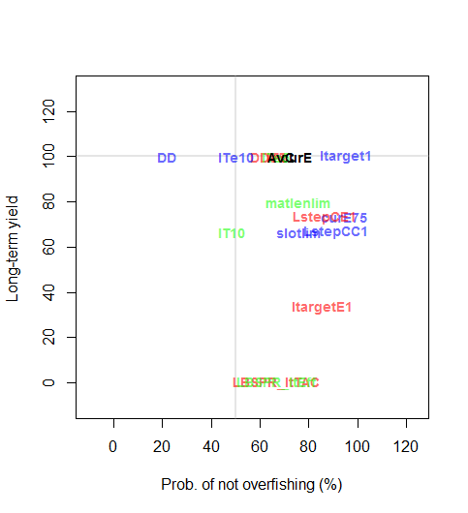

Slide 10
Conclusions
It is straightforward to test robustness of MPs to time-varying growth and recruitment processes
Growth and recruitment phenomenon have unpredictable impacts on MP performance.

